Slide 1




MASTER PROGRAM IN
DATA SCIENCE AI & MACHINE LEARNING
www.mcta.co.in

Slide 2



Supervised predictive models
Contents covered
Regression and Classification techniques
www.mcta.co.in

Slide 3
Contents covered
Simple Linear Regression
Ordinary least square
Assumptions of linear regression
2. Multi-variate Linear regression
- Multi collinearity, No auto correlation, Homodescacity, using null hypothesis
www.mcta.co.in

Slide 4
Simple linear regression
Linear regression is used to show the relationship between a dependent variable (y-axis) and an independent variable (x-axis). For example
Showing how Income (y-axis) grows with age (x-axis)
How house price (y-axis) grows with area (x-axis)
How RPM (y-axis) of a tyre grows with acceleration (x-axis)
The above use cases are solved with linear regression where the y-axis is dependent only on 1 variable
Say we would like to plot the relationship between the exams grades of a student and the time he spends on Facebook (here, the more the time spend on Facebook, the lesser the grades)
The formula for simple linear regression is denoted as follows
Y = mx + b
Where Y represents the variable we are predicting (exam grades), x= time spent on facebook
m = Slope
b = Intercept (distance between 0 and the point from where the regression line starts)
www.mcta.co.in

Slide 5
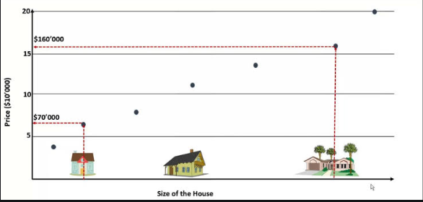
Simple linear regression
The diagram below demonstrates, how the price of the house grows with the size
So the bigger the house, higher the price on (y-axis)
Check python notebook- “regression techniques” for the code implementation
Also check R-Squared in previous lesson, Introduction to machine learning
www.mcta.co.in

Slide 6
Simple linear regression
Assumptions of Linear Regression
Linear regression is an analysis that assesses whether one or more predictor variables explain the dependent (criterion) variable. The regression has five key assumptions:
Linear relationship
No auto-correlation
Homoscedasticity
Little multi collinearity
Each of these terms are briefly described as follows
Linear relationship –
On plotting the independent and dependent variables on the graph, there has to be a linear relationship established, that is, the independent variable should grow with dependent variable and vice versa
For example – the house price should grow with area of the house
www.mcta.co.in

Slide 7
Simple linear regression
Little multi collinearity -
Multicollinearity is a state of high correlation between 2 or more independent variable
The best way to treat this is dropping one of the independent variables of 2 variables are highly correlated ( ie : more than 50% )
No auto-correlation –
Before we jump to No auto-correlation lets discuss what auto-correlation means,
Auto correlation or serial correlation is the similarity in residuals (actual-predicted) when compared between the original time series and the lagged version of itself
Auto correlation establishes the relationship between the residuals of current value and past value for example the change in temperature from previous day or change in stock price from previous day
Now its essential for to drop one of the two independent variable since one of them don’t add any significant information to the model
www.mcta.co.in

Slide 8
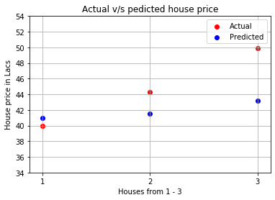
Performance metric
Root Mean Squared Error (RMSE) -
RMSE is just the square root of MSE. The square root is introduced to make scale of the errors to be the same as the scale of targets
Consider the previous house price prediction of 3 houses in Mumbai and we come up with the following values
House 1 = 41 Lac, House 2 = 41.5 Lac, House 3 = 43.2 Lac
Whereas the actual price of the house is
House 1 = 40Lac, House 2 = 44.3 Lac,
House 3 = 49.9 Lac
We got the MSE as 17.91.
Hence according the the definition,
RMSE is the square root of MSE,
hence RMSE for 17.91 = 4.23
www.mcta.co.in

Slide 9
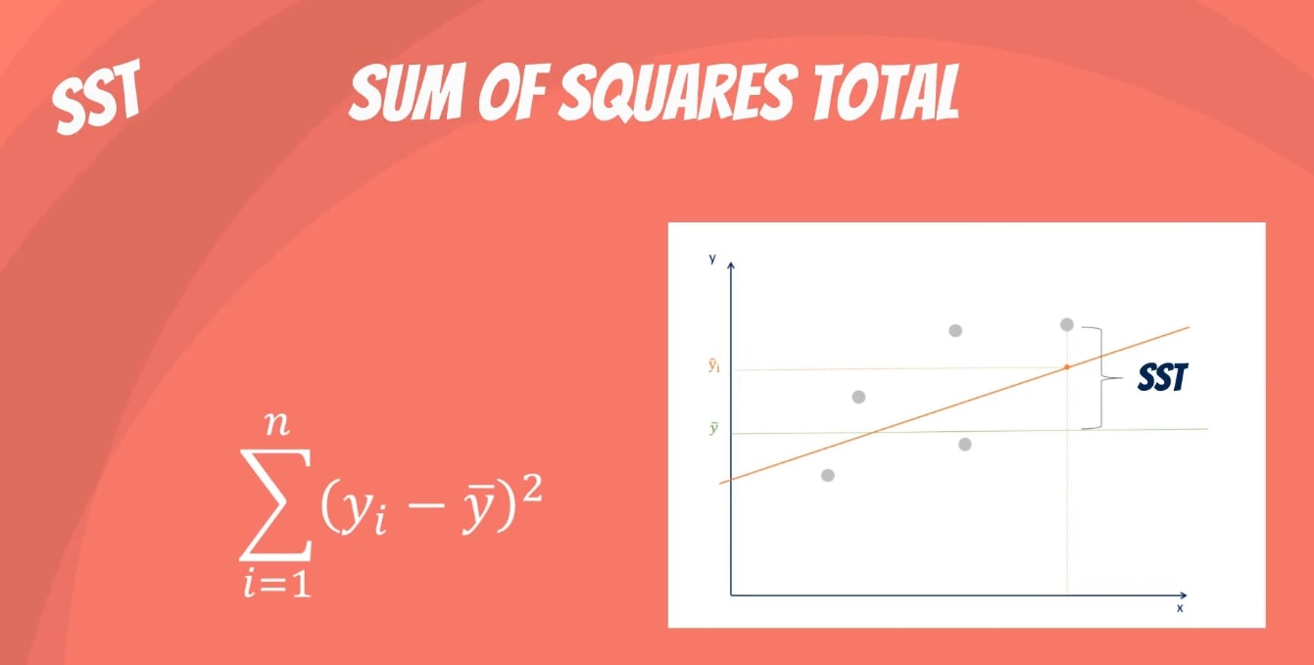
Performance metric
What is the SST?
The sum of squares total, denoted SST, is the squared differences between the observed dependent variable and its mean. You can think of this as the dispersion of the observed variables around the mean – much like the variance in descriptive statistics.
www.mcta.co.in

Slide 10
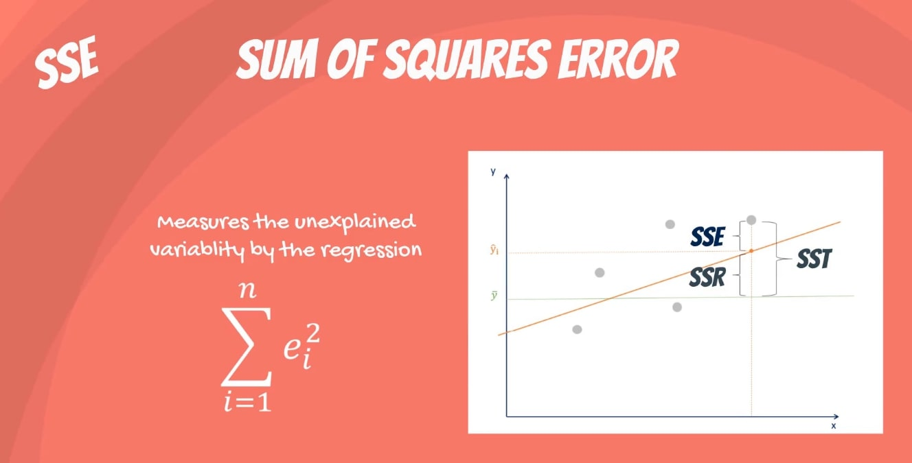
Performance metric
What is the SSE?
The last term is the sum of squares error, or SSE.
The error is the difference between the observed value and the predicted value.
We usually want to minimize the error. The smaller the error, the better the estimation power of the regression. Finally, I should add that it is also known as RSS or residual sum of squares. Residual as in: remaining or unexplained.
www.mcta.co.in

Slide 11
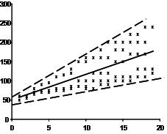
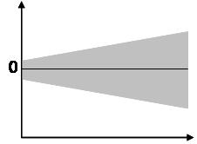
Simple linear regression
Homoscedasticity –
The scatter plot is good way to check whether the data are homoscedastic (meaning the residuals are equal across the regression line). The following scatter plots show examples of data that are not homoscedastic (i.e., heteroscedastic):
www.mcta.co.in

Slide 12
Multi-variate Linear Regression
Multi-variate Linear Regression In the previous tutorial we just figured out how to solve a simple linear regression model. A dependent variable guided by a single independent variable is a good start but of very less use in real world scenarios. Generally one dependent variable depends on multiple factors. For example, the rent of a house depends on many factors like the neighborhood it is in, size of it, no.of rooms, attached facilities, distance of nearest station from it, distance of nearest shopping area from it, etc. How do we deal with such scenarios? Let's jump into multivariate linear regression and figure this out
Here, there are multiple independent variables that contribute to the movement of the price that we are predicting
Unlike simple linear regression { y= mx + b },
Multi-variate linear regression is equated like so :- { y = mx1 + mx2 + b}, where x1, x2…xn are the number of independent variables like house size, number of rooms etc
Check the notebook Regression Models.ipynb for implementation in python
www.mcta.co.in

Slide 13
Regression Techniques
Trivia
Please solve the following questions
What is the difference between linear regression and multivariate linear regression
What are the assumptions of linear regression
What is multi collinearity and why should we avoid it
What is homoscedasticity
www.mcta.co.in

Slide 14

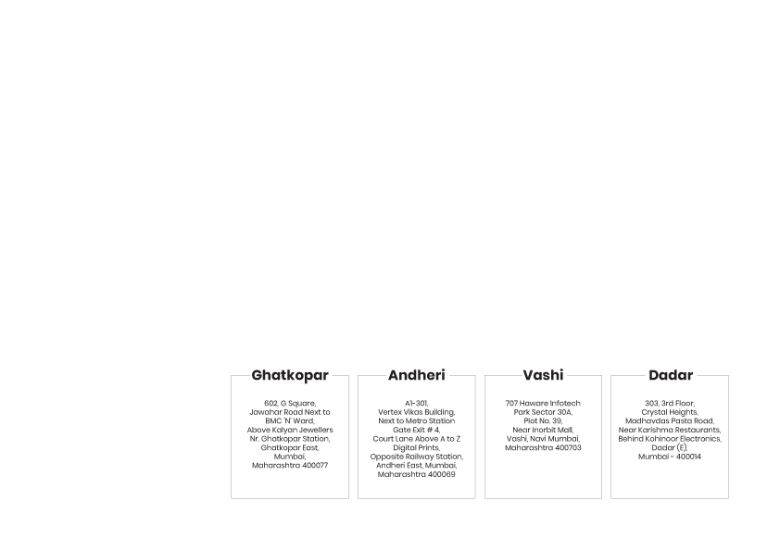
BE AN EXPERT DATA SCIENTIST!
www.mcta.co.in

